Slide 1
Project Shutdown
Developed By
Nuril Hijas S(201603035)
Durai Raj M(201603018)

Slide 2
OVERVIEW
DESCRIPTION
FLOW CHART
PROPOSED SYSTEM
IMPLEMENTATION
OUTPUT
CONCLUSION

Slide 3
DESCRIPTION:
This project describes the Shutdown Application. The central aim of the project is to perform to shutdown the android mobile phones. The user can able to shutdown the another android phone using Socket connectivity. The user can write the Mobile IP and port number and it will connect to another mobile and it turns to shutdown.

Slide 4
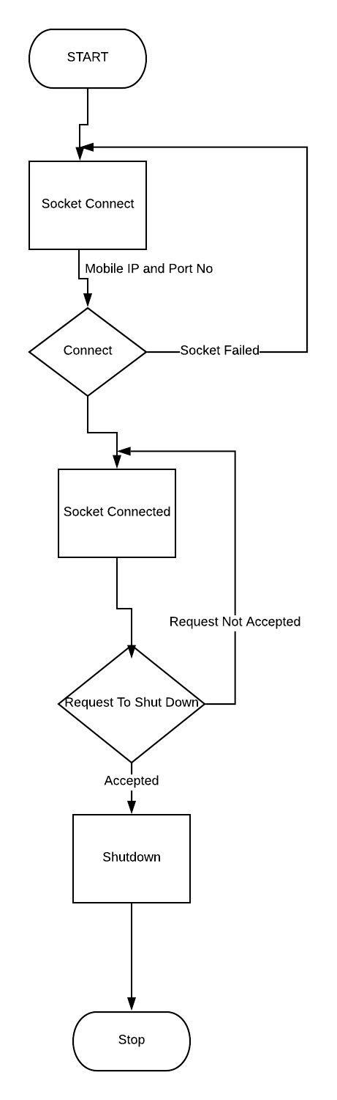
FLOW CHART

Slide 5
PROPOSED SYSTEM:
TECNOLOGY TO BE USED:
Android Mobiles
Android studio

Slide 6
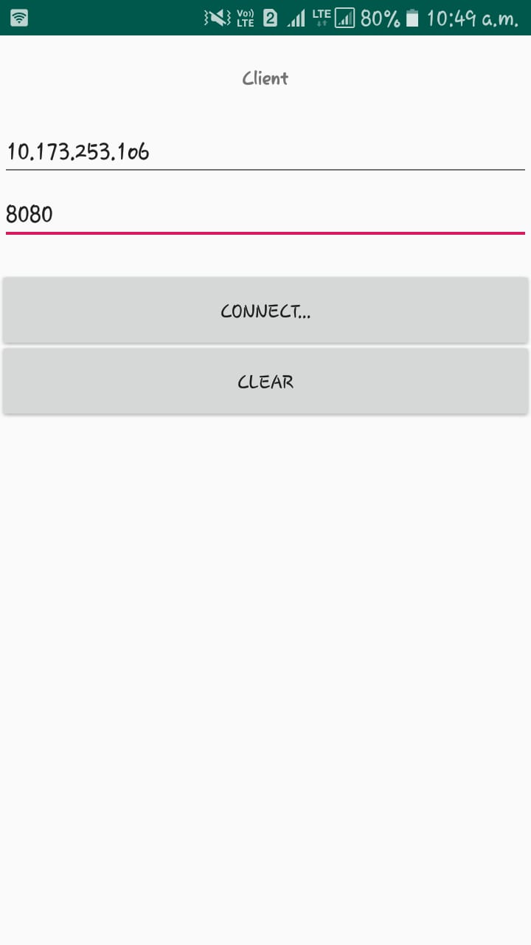
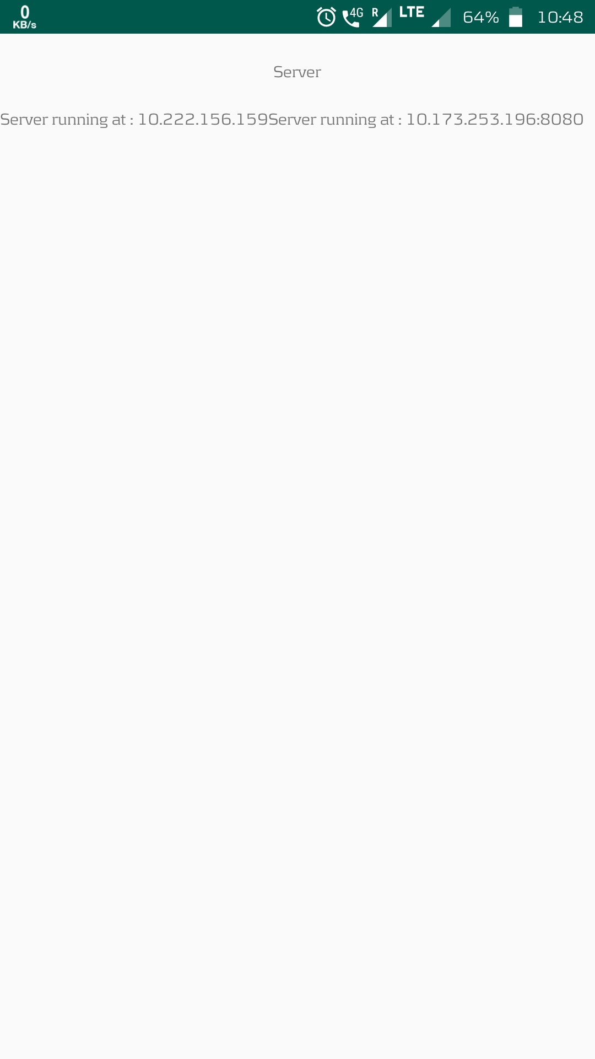
IMPLEMENTATION:

Slide 7
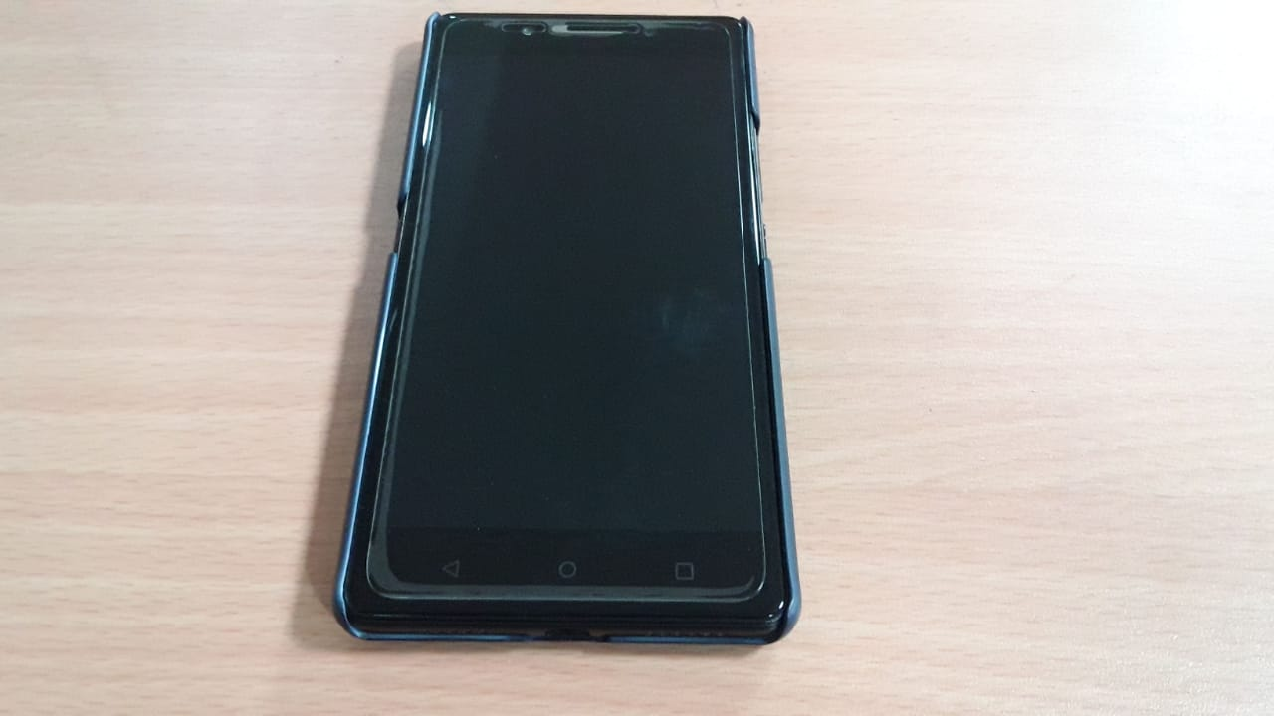
OUTPUT:

Slide 8
CONCLUSION:
Thus the project which performs shutdown the android mobile and it will connect with socket programing using Android studio.

